Slide 1
How Trade Unions help learning at work
Presentation to International Workshop no 3. 4th World Forum, Lifelong Learning for All, ICAE and CMA, UNESCO Paris, 6th February 2015
By TOM WILSON , Unionlearn

Slide 2
Session internationale N°3
Tom
WILSON
4e forum mondial/
4th world forum
Expert
Directeur de UNIONLEARN, Trades Union Congress UK (TUC)
Director of Unionlearn, Trade Union Congress, TUC
 fr : 3 / en : 1
5
& 6 février
Sous le patronage de la Commission nationale française
Paris UNESCO
2015
auprès de l’UNESCO
France
Notes:
2

Slide 3
What is Unionlearn?
“Unionlearn” is another name for the Education Dept of the Trades Union Congress – the TUC.
The TUC is the umbrella body for all the Trade unions in the UK.
Unionlearn has 60 staff and an income of £16M
In 2014 it helped 240,000 learners at work.

Slide 4
What is union Learning?
Unions help their members to learn
Help managers improve training
Celebrate employees’ learning
Set up workplace Learning centres
Make links with Colleges
Help families and friends and communities
1.5M union learners in 6 years

Slide 5
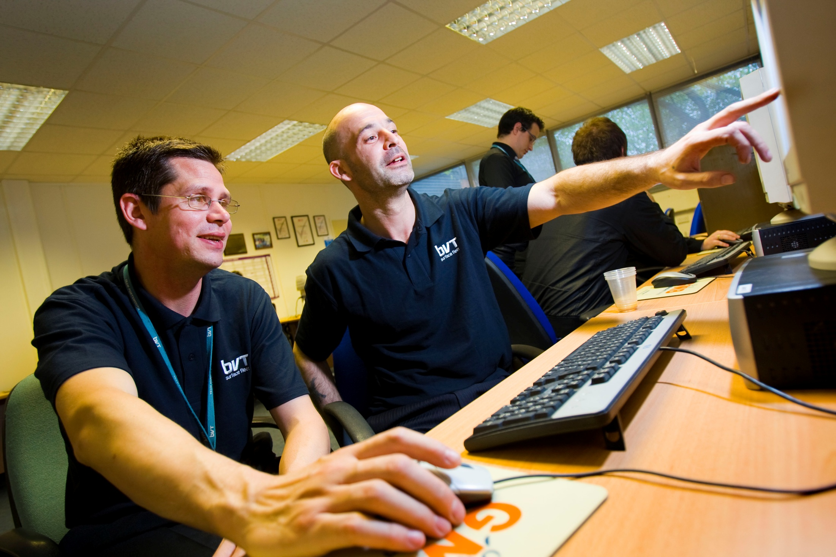
GMB – Trade Union members learning ICT Skills

Slide 6
What sort of learning?
Basic English, maths, computers
Informal courses – to get back into learning
Special courses for work: management, customer relations, law, finance, Health, everything!
At all levels from Basic to University
For all ages: Apprentices, technicians, professionals, Mid career

Slide 7
Employers like union learning
Employers don't always like Trade Unions but they do like
union Learning :
87% of employers want more union learning
91% say unions should do more to help learning
53% said it improved levels of trust at work
52% said it improved morale
88% gave more paid time off to learn
78% invested more money in learning
55% of staff gained qualifications

Slide 8
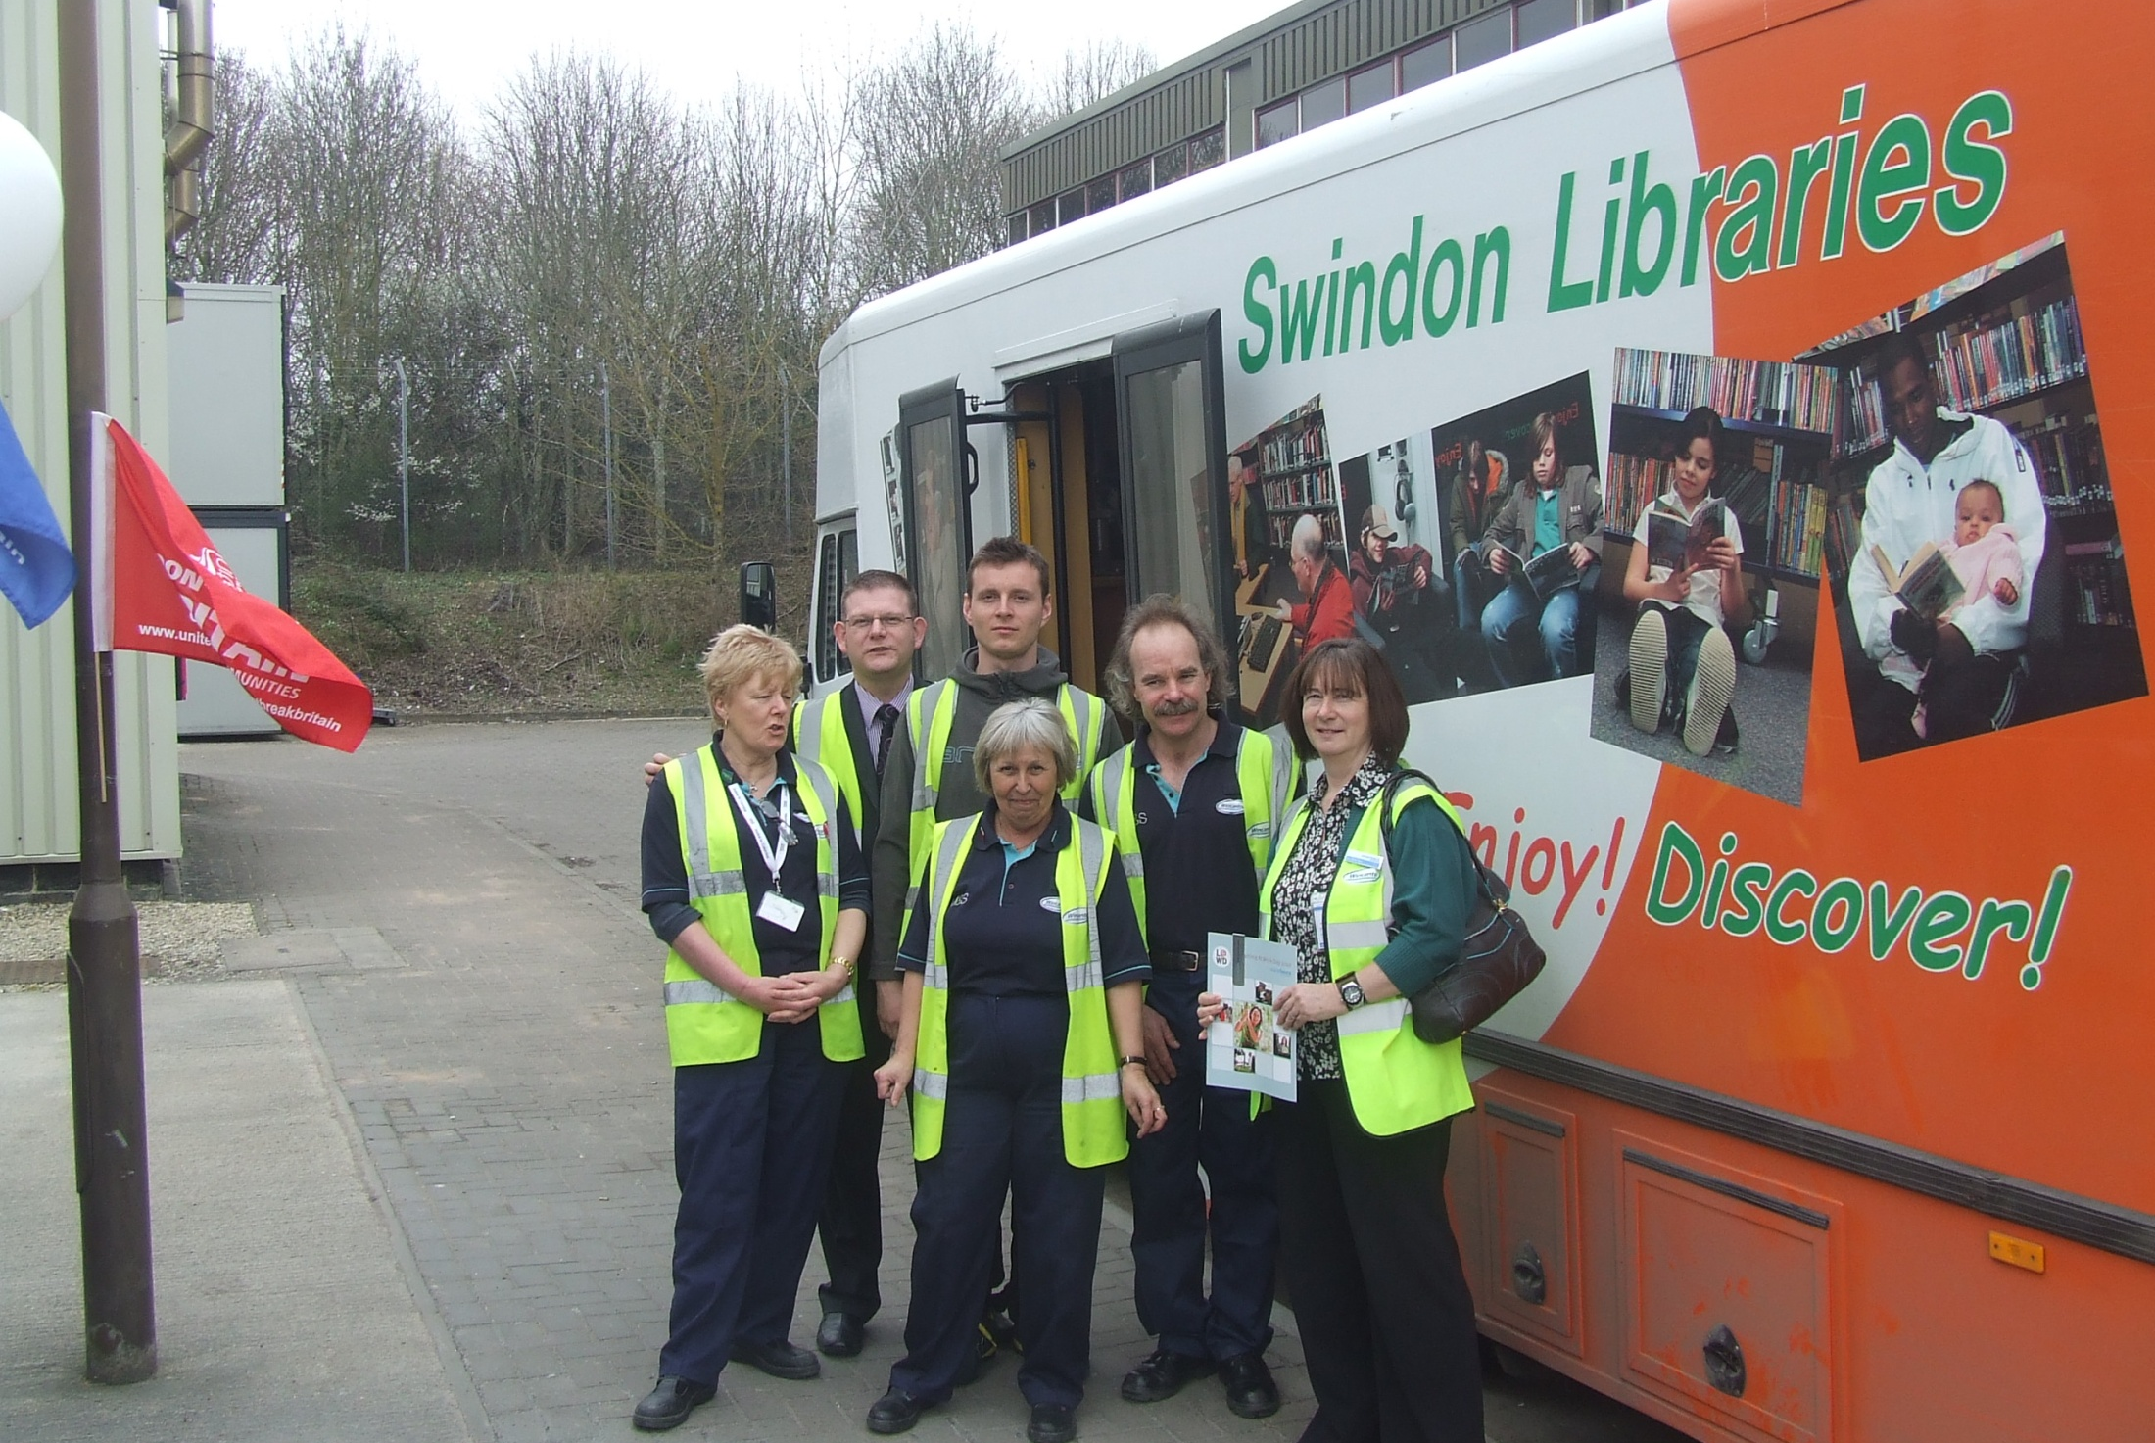
Unite – Trade Union workers organised a mobile library visit

Slide 9
Why union learning work:1
Would you admit problems to your manager?
But you would to a fellow employee
Or to your “Union Learning Representative”
And managers need to know, want to talk to ULR
So its “win – win”

Slide 10
Why union learning works: 2
Learning at work is more convenient,
Especially for busy parents,
Work is a familiar environment,
Its learning alongside work friends

Slide 11
Why union learning works: 3
Learners are involved – and so motivated
They learn where, how, when, what they want
They are treated as adults – not back in the
classroom
Among friends, learning together

Slide 12
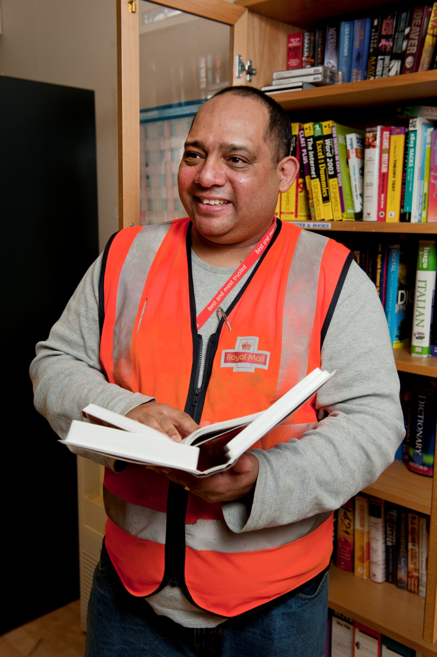
A postal worker and union learning rep in the Post Office learning centre

Slide 13
The evidence that union learning works
Double the normal take-up of courses
Much higher retention, lower drop-out
90% pass rates – normally around 70%
Much higher progression rates to higher courses

Slide 14
Who pays for it?
£14M funding from government
£1M from the TUC
£1.5M from Trusts, Charities etc
£90M from employers
£10M from unions

Slide 15
Apprentices who helped build the London Olympic Stadium

Slide 16
The future?
Strong UK government, EU, OECD support
Work is increasingly about skills and learning –
the “Knowledge economy”
Focus moving from learning outside work to
learning in work

Slide 17
To Learn More
twilson@tuc.org.uk
www.unionlearn.org.uk
Thanks for listening!

