Slide 1
A Structural Intervention towards Better Health & Education Outcomes for Girls
Experiences from SAMATA
Tejaswini Hiremath
Karnataka Health Promotion Trust

Slide 2
BACKGROUND
South Asia has the highest gender gap in education in the world, with two third of out-of-school children being girls
School enrolment rates have increased in India but retention is low and gender gaps persists. Drop out rates are high for girls.
Traditional customs and rituals discriminate girls for continuing education. Patriarchal norms, poverty and caste status, structural obstacles to education disadvantage girls.
Gender roles and gender socialization processes gets firmed up at family and schools

Slide 3
CONTEXT
Rates of HIV infection in northern Karnataka are among the highest in India.
Many girls drop out of school as a result of poverty, early marriage, a tradition of sex work and the under-valuing of girls’ education.
Among SC/ST girls, 53% in Bagalkot and 38% in Bijapur married before the age of 18.
Over 70% of female sex workers are from SC/ST communities, enter into sex work before 18 years of age and are initited into sex work as part of the devadasi tradition.

Slide 4
PROBLEM SUMMARY
Poverty and low value for girls’ education incline families to remove daughters from school
Existing gender norms allow boys to be disrespectful toward girls and devalue girls’ education
SDMCs and school staff don’t systematically conduct a gender analysis or effectively address needs of girls to retain them in schools
PRIs, community groups, and schools don’t take initiative to protect and enforce girls’ right to education
Girls lack role models, aspiration for professional careers and sense of solidarity with other girls

Slide 5
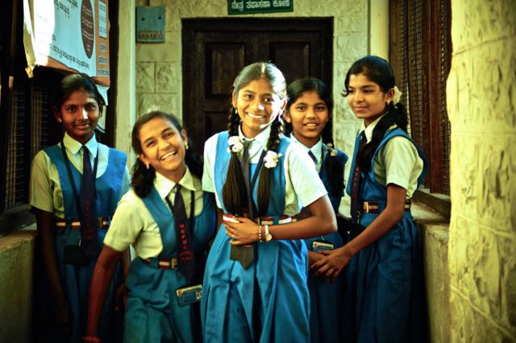
SAMATA – KEEPING GIRLS IN SECONDARY SCHOOL

Slide 6
SAMATA - An Education & Health Initiative
Goal – “to improve quality of life of adolescent girls from marginalised communities by keeping girls in school, delaying marriage and reducing entry into sex work”
A structural intervention and it’s evaluation that is building evidence on the impact of high school entry and retention on delaying the age at sexual debut, age at marriage and reduced vulnerability to HIV among adolescent girls

Slide 7
SAMATA - A Health & Education Initiative
Goal – “to improve quality of life of adolescent girls from marginalised communities by keeping girls in school, delaying marriage and reducing entry into sex work”
A structural intervention and it’s evaluation that is building evidence on the impact of high school entry and retention on delaying the age at sexual debut, age at marriage and reduced vulnerability to HIV among adolescent girls

Slide 8
Samata’s interventions work to challenge negative gender norms and promote the adoption of postivie ones.
INTERVENTION STRATEGIES
provides special tuition, career counselling and leadership training to improve girls’ academic success and broaden their aspirations
establishes reflection sessions for girls to share experiences and build solidarity and confidence
sensitises parents to value girls and recognise the importance of educating them

Slide 9
INTERVENTION STRATEGIES
links families to government schemes that provide incentives for educating girls
uses sports to encourage boys to respect girls and appreciate their rights
trains SDMCs and school staff to institute measures to increase girls’ safety and academic success
supports community structures to understand the importance of girls’ education and take action

Slide 10
RESEARCH aims to:
Assess the impact of the intervention on transition to and retention of SC/ST girls in schools and communities who have access to the intervention
Assess the impact of the intervention on age at marriage, age at sexual debut and age of entry into sex work among adolescent SC/ST girls in schools and communities that have access to the intervention

Slide 11
RESEARCH aims to:
Explore how the intervention has affected the response of schools and the communities to high school discontinuation by SC/ST girls
Investigate the processes and causal pathways through which positive changes occur in the following areas:
support and value for education;
self-esteem and confidence among adolescent girls;
self-perceived safety and social status among adolescent girls and in their social networks; and
culturally prescribed social expectations and gender norms

Slide 12
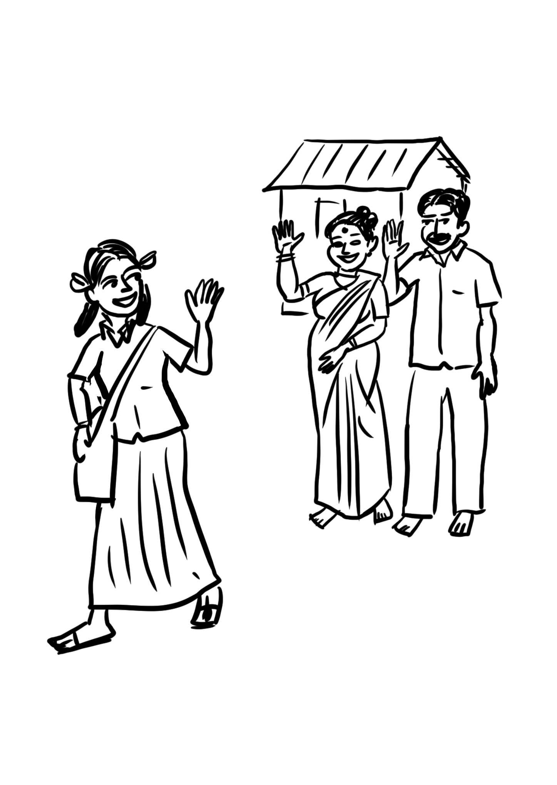
WHAT WILL SUCCESS LOOK LIKE?
Girls gain confidence and leadership
Parents are involved in girls’ education

Slide 13
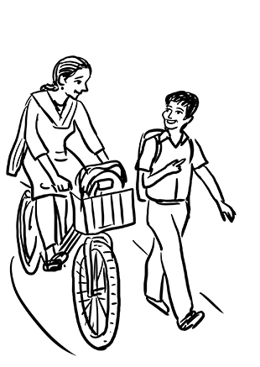
Boys accept girls as equal classmates

Slide 14
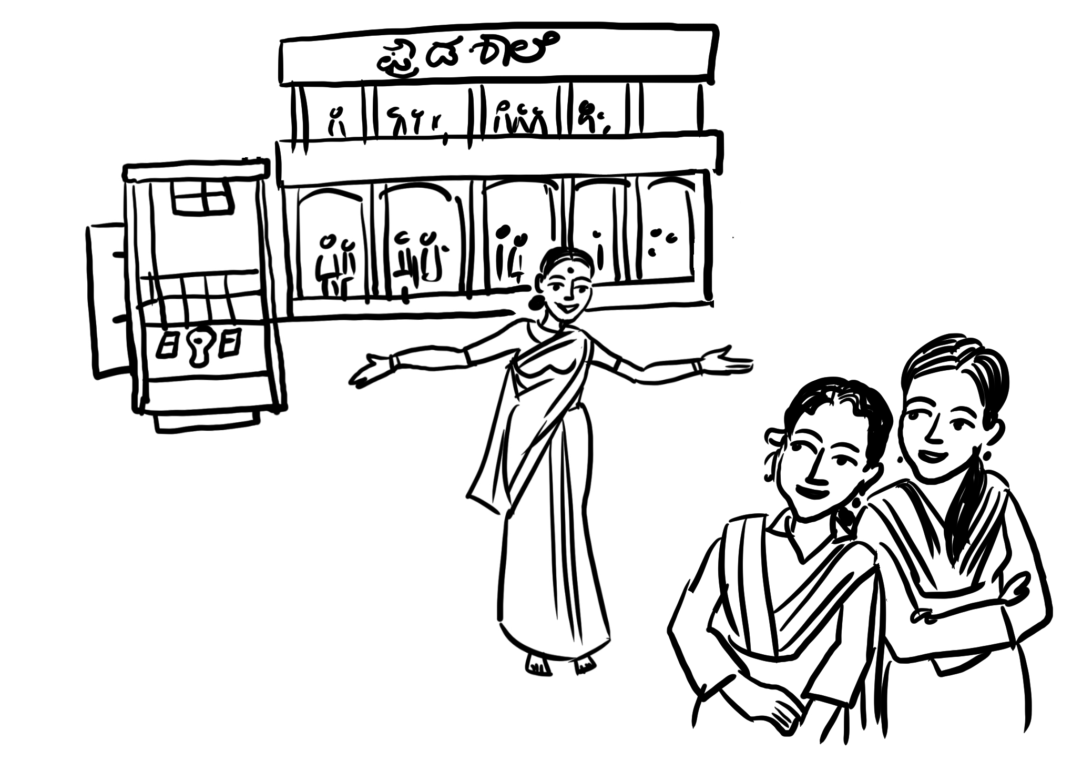
Schools cater to girls’ needs

Slide 15
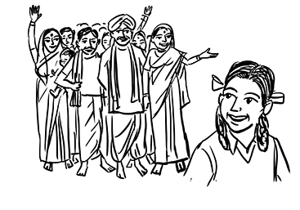
The community values girls’ education

