Slide 1

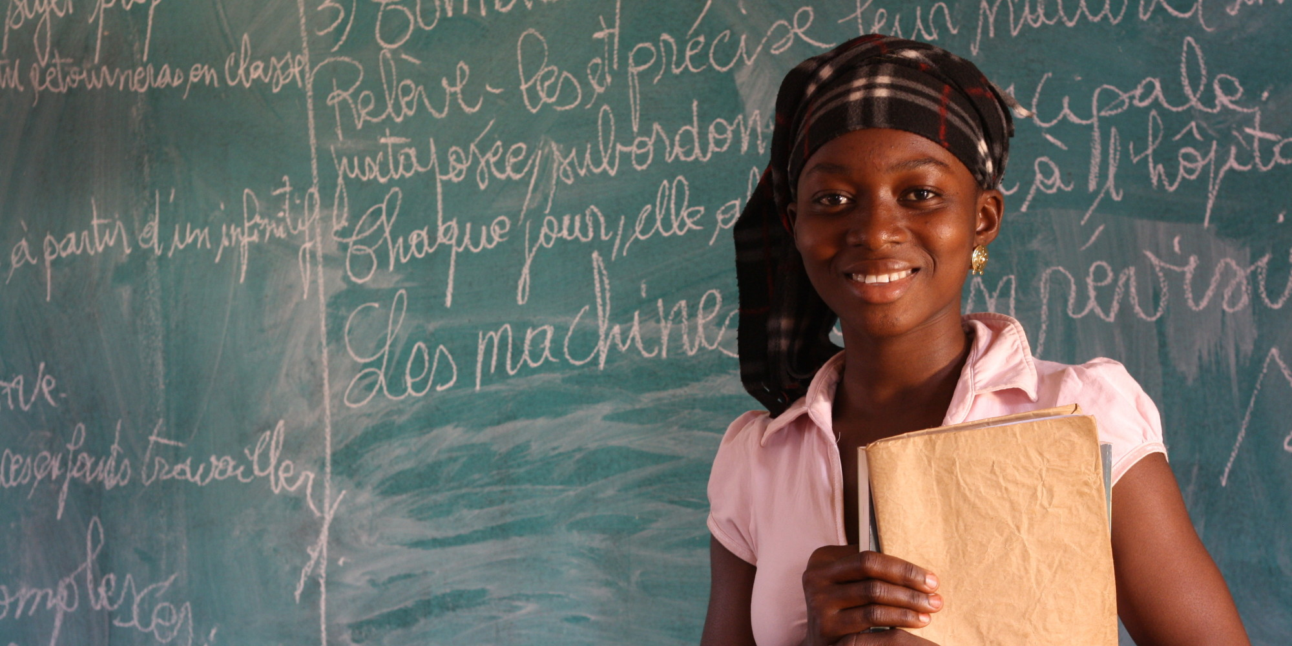
Strengthening global leadership on
comprehensiVe sexuality education
Unesco’s approach and activities
JOANNA HERAT
TEAM LEADER: SEXUALITY EDUCATION, SRH AND GENDER EQUALITY
SECTION FOR HEALTH AND GLOBAL CITIZENSHIP EDUCATION
EDUCATION SECTOR
5TH FEBRUARY 2015 4TH FORUM - LIFE LONG LEARNING FOR ALL
Notes:
Delighted to be here
I am Joanna
Talk about the role that UNESCO plays in health education, particularly looking at our role in strengthening the uptake and implementation of sexualtiy education around the world.

Slide 2

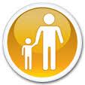
EDUCATION MATTERS
UNESCO believes that education provides an ideal opportunity to reach large numbers of young people with correct and appropriate information.
Schools are a venue for implementing well designed comprehensive sexuality education programs that provide knowledge and skills essential to practice safer behaviors.
Schools provide a platform for targeted care and support interventions especially for vulnerable children and adolescents.

Slide 3
Gender equality
Economic opportunity
Environmental sustainability
Health
“Education is the single best investment countries can make towards building prosperous, healthy and equitable societies.”
Global education First Initiative
Notes:
In 2012, the UN Secretary General Launched the UN Global Education First Initiative placing education at the heart of development. As we can see from this diagram, taken from the Global Education First Framework, the benefits of education is vast in terms of all of the major drivers of development: economic opportunity, health, gender equality and environmental sustainability. UNESCO is the leading agency working on Education within the UN family – our goal is to strengthen the education sector in all of our member states, to ensure that children, and adults, have access to these same development opportunities.
The impact of education on health is of particular concern to us as Healthy learners learn better and better educated learners have the skills to be healthy. Our work on health education covers HIV, comprehensive sexuality education, and other related school health topics. Education has the potential to improve individual health, saving lives from preventable diseases, and education In general can be said to act as a social vaccine against major diseases such as AIDS, TB and Malaria.
Education = Development
Development = gender equality + economic opportunity + environmental sustainability + health

Slide 4

School attendance has been shown to reduce sexual risk behavior as well as HIV incidence.
Increased
School
attendance
29%
reduction of new HIV infections among 15-19 year old girls
(2015 study in Rakai Uganda)
Notes:
School attendance has been shown to reduce sexual risk behavior as well as HIV incidence- 2015 study in Rakai Uganda: Increased primary education is credited with reducing 29% of new HIV infections among 15-19 year old girls.
We know from Research that youth who attend school are:
Less likely to initiate sex at an early age than non-students
More likely to use contraception/condoms than non-students

Slide 5
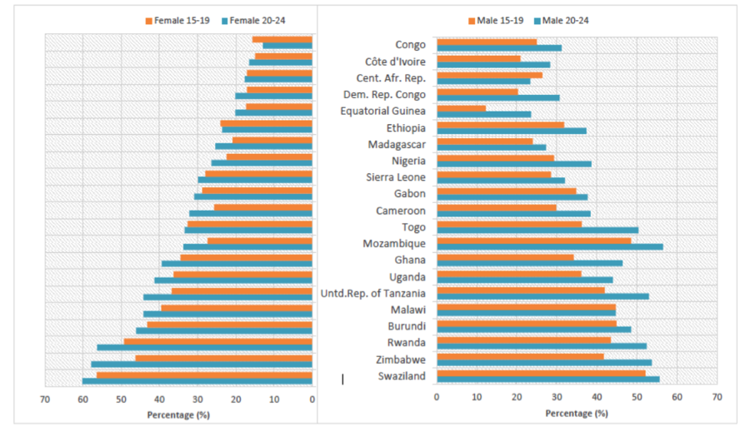
Comprehensive Knowledge of HIV
(15-19 years old in SSA)
% of adolescent and young males and females (15-24 years) with a comprehensive/correct knowledge of HIV, in select Sub-Saharan African countries. (2010-2014) (UNICEF Global HIV and AIDS databases based on MICS, DHS, AIS and other nationally representative household surveys, 2010-2014)
Notes:
Young people’s knowledge levels on HIV remain low with less than 40% of young people in the ESA region having sufficient knowledge on HIV prevention.
Regional average stands at 41%for men and 33% for women
Many YP especially young women grow into adolescence and adulthood without much knowledge about their reproductive health and about safe and healthy relationships.

Slide 6

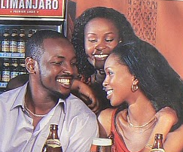
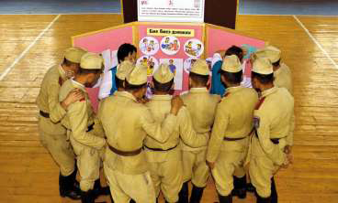
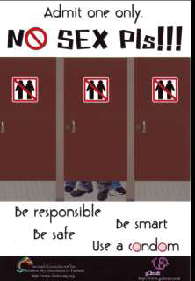

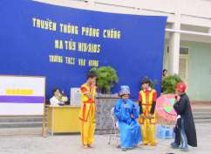


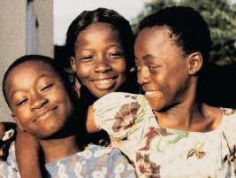

Why is sexuality education important?
Fewer than 40% of young people have basic information about HIV
Young people lack knowledge on contraception and practical skills on contraception use
66% of girls on average know nothing about menstruation until menarche
Conflicting and confusing messages
about sexuality and gender

Slide 7
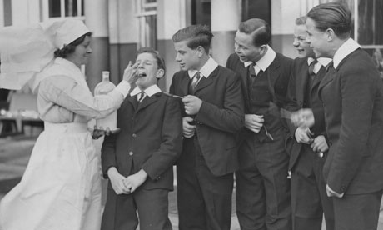
School health & sexuality education – fit for purpose for a modern world?
Notes:
So if we know that school health, and health education are so critical, we have to ask ourselves if children are receiving the kinds of support and interventions that are fit for purpose for our modern world.
Quelle response a mettre en œuvre par l’education nationale? Comment pouvons nous, - responsables de la sante, de la protection et de l’education des enfants et jeunes) mettre a jour nos approches afin de repondres aux besoins reels des jeuns?
Je crois qu nous avons déjà bcp progresse depuis les jours de cette infirmiere bienveillante mais peutetre dure, autocrate et tres medicalise. Si je me souviens de l’approche ‘sante’ de l’ecole de ma propre enfance, je l’espere bien!
Donc, quels sont les axes cle pour la reussite?
D’abord.
Partenariat entre les secteurs de l’education, la sante et les service sociaux surtout en ce qui concerne la protection de l’enfance
Basé sur les droits. Basee sur les besoins reelle des enfants et jeunes
Rien ne sera possible sans la formation et le soutien continue aux professionnels – enseignants... etc

Slide 8
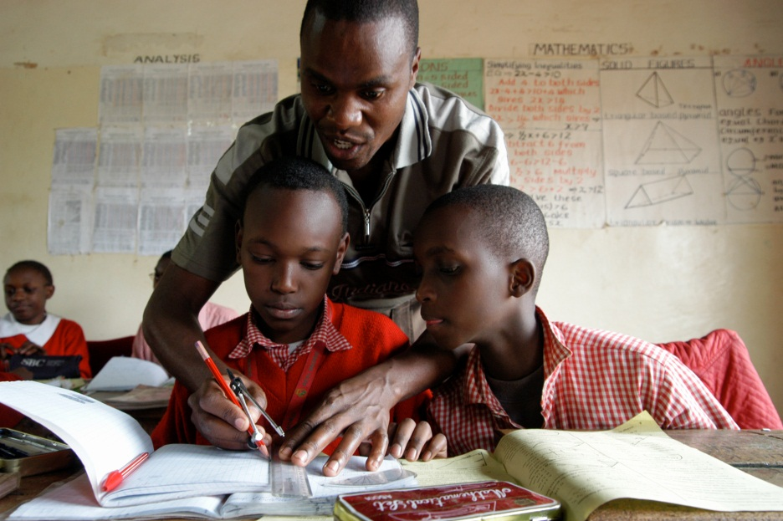
Education sector responses – global perspectives
Sexuality education in much of Europe since 1950s but varying content and quality
In Africa, HIV prevention taught through Life Skills since 1990s. Most countries have achieved fairly good coverage.
Latin America inclusion of sexuality education and health through citizenship – content not always comprehensive
Asia – some life-skills, some health but very limited on sexual health
Overall challenges:
  key aspects of sex and sexual health are often lacking (i.e. information about reproduction, STIs, abortion and where to access condoms or other SRH services)
  Educators are not equipped to deal with sexuality issues therefore they are not comfortable talking to students about sexuality.

Slide 9
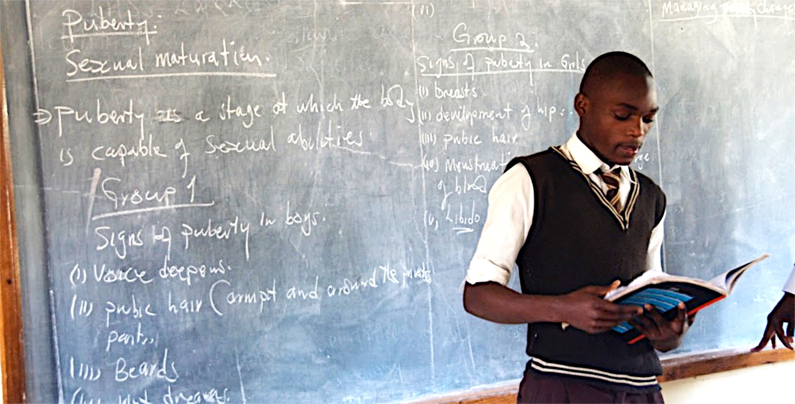
Comprehensive sexuality education
Comprehensive sexuality Education is an age-appropriate, culturally relevant approach to teaching about sex and relationships by providing scientifically accurate, realistic, non-judgemental information.
CSE is most effective when it highlights a gender and rights perspective. Such an approach to CSE empowers young people to protect their own health)
Notes:
Sexuality education provides opportunities to explore one’s own values and attitudes and to build decision- making, communication and risk reduction skills about many aspects of sexuality.
Sexuality education is an essential part of a good school curriculum and an essential part of a comprehensive response to AIDS at the national level. Comprehensive sexuality education is a platform for HIV prevention.
CSE programs should reach young people before they become sexual active

Slide 10
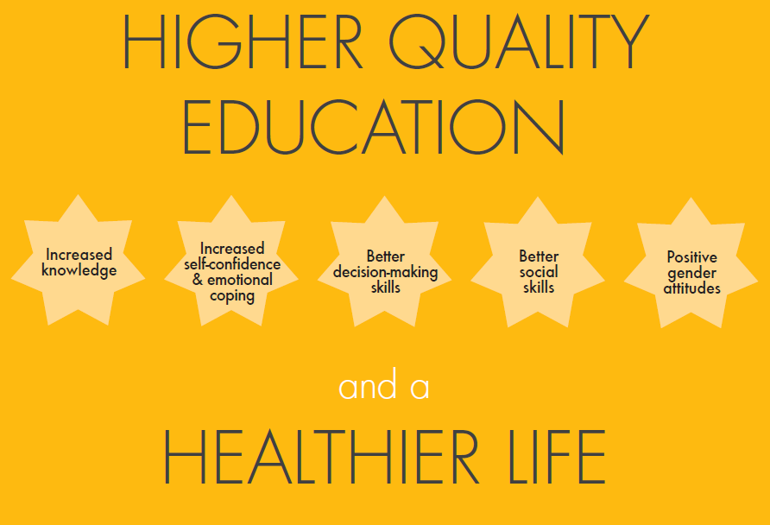
BENEFITS OF SEXUALITY EDUCATION
Notes:
The pathways to better health and wellbeing are multiple, and these are the areas where good quality education, in general, but particularly sexuality education, can make a difference
READ the stars

Slide 11
The impact of school based CSE programs
Does NOT encourage young people to have sex
Most programs had positive impacts on one or more sexual behaviors including:
    Delay initiation of intercourse (increase abstinence)
    Reduce number of sexual partners
    Increase use of condoms/contraception
    Reduce unprotected sex
Many CSE programs have significant, durable effects on knowledge, attitudes, self-efficacy and intentions to change behavior
Behavioral outcomes- Data is mixed because the quality of CSE varies greatly; behavioral outcomes are also usually self-reported
Biological outcomes: While elsewhere studies have shown impact on biological outcomes
Are an effective component of a comprehensive approach that addresses behavior and structural causes of vulnerability and includes access to youth friendly SRH services.
Notes:
The only two school-based studies—both of them randomized controlled trials that measured HIV incidence outcomes found no impact on HIV incidence
The impacts on behaviors may have been too small to impact HIV incidence….

Slide 12
UNESCO’s mission in the area of health education
We want to promote healthy lifestyles among girls, boys, young women and men through skills-based education - in formal educational settings, non-formal educational activities, and informal education
Good health ensures access to schooling, enables children and young people to stay in school, and strengthens their contribution to and participation as citizens in society
We also want ALL learners to be able to learn and educators to teach in a safe learning environment free of stigma, discrimination and violence
Notes:
So what is exactly what UNESCO wants to achieve in the area of health education to respond to the situation I just described?
We have a two prong approach. Our first goal is to promote healthy lifestyles, our target group is children and young people because of UNESCO’s mandate and our main strategy is of course education, particularly skills-based education – mostly in formal education which is the bulk of our work but also in non-formal and informal education
We strongly believe that there is a causal effect between goad health, access to education and children and young people being able to fully participate in society as educated and healthy citizens
However beyond this well accepted definition of health education, we believe also that our goal is to make sure that learning environments are « healthy », ie safe for absolutely all children and in particular absolutely free of stigma, discrimination and violence

Slide 13
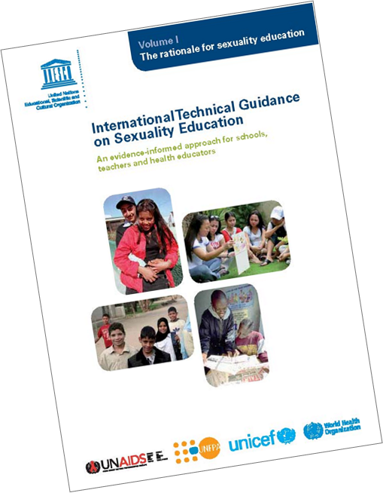
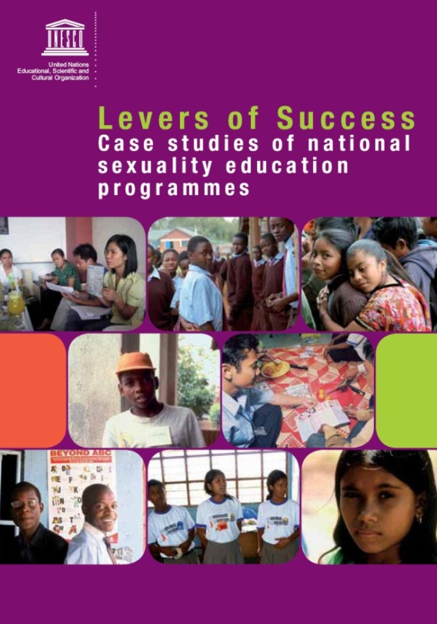
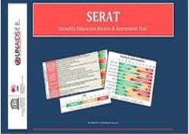
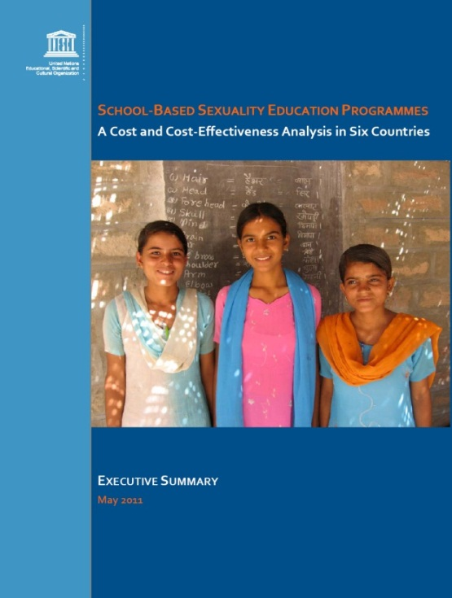
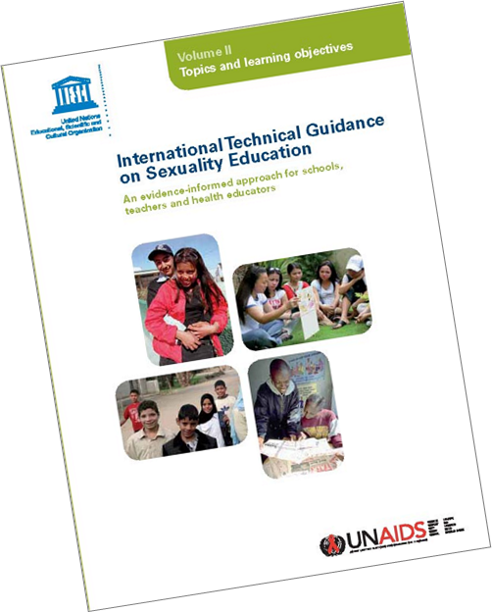
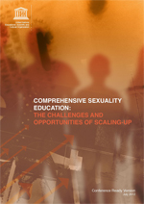
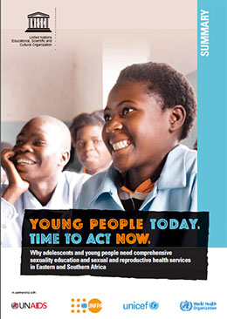
TOOLS

Slide 14
KEY APPROACHES FOR STRENGTHENING SEXUALITY EDUCATION
CURICULUM
TEACHERS
POLICY
Good quality curriculum that addresses health issues, gender equality and personal empowerment
Well trained and supported teachers using participatory pedagogy and supporting the critical enquiry of learners
Supportive policy and legal environment
Notes:
Work at global, regional and coutnry level
Global level: Development and dissemination of policy and programmatic guidance setting international standards based on research and documentation of good practice
Country level: Technical support to ministries of education and other key stakeholders in the education sector:
Review and assessment of existing programmes
Training & capacity building, e.g. curriculum development and teacher training
Monitoring & Evaluation (M&E)
All levels: Evidence-based advocacy & communications

Slide 15
SOME EXAMPLES OF WORK IN THE FIELD
Eastern & Southern Africa: political committment, teacher training tools, curricula assessment, tools for community engagement including TV & radio
West & Central Africa: curriculum on gender & violence, training tools for peer educators, sexualtiy education review and assessments
Eastern Europe & Central Asia: internet and social media, teacher training, linkage schools and services, advocacy for youth
Latin America and Caribbean: citizenship education, life skills, and health literacy, teacher training
Asia Pacific: research and projects on homophobic and transphobic bullying
Middle East & North Africa: teacher training module, study on school-related gender-based violence

Slide 16

THANK YOU
JOANNA HERAT
J.HERAT@UNESCO.ORG

